Slide 1
Interactive Digital Photomontage
Aseem Agarwala, Mira Dontcheva et al.
University of Washington
SIGGRAPH’ 04
Presenter: 林昭炜

Slide 2
Outline
Segmentation
Ineraction Penalty
Inertia
Gradient domain fusion
Results
Discussions

Slide 3
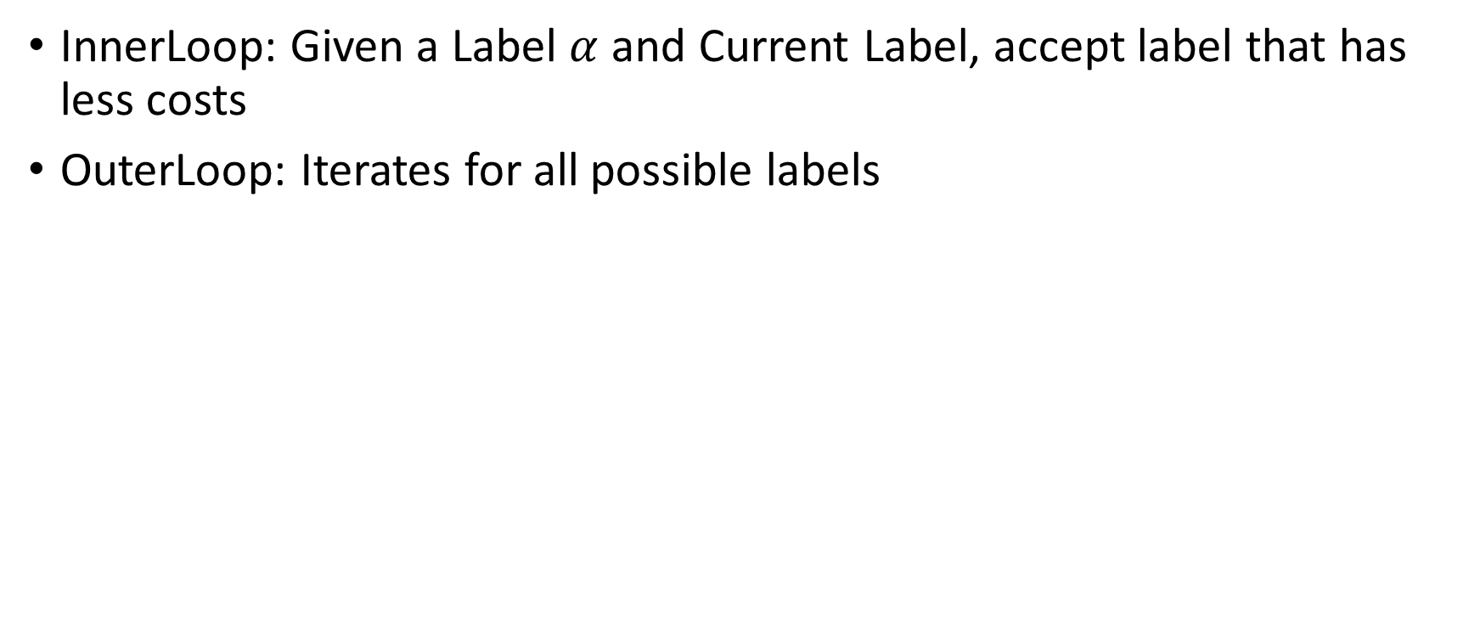
Using Graph-cut
InnerLoop: Given a Label $α$ and Current Label, accept label that has less costs
OuterLoop: Iterates for all possible labels

Slide 4

Graph-cut
$$C\left(l\right)= \sum_{p}{C_{d}\left(p, L\left(p\right)\right)+\sum_{p,q}{C_{i}(p, q, L\left(p), L(q\right))}}$$

Slide 5
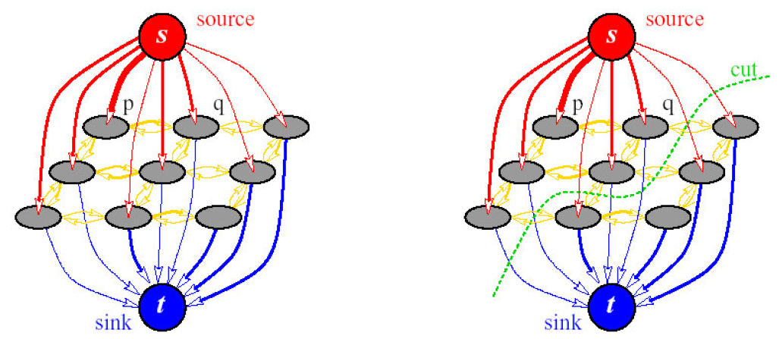

Graph-cut
$$C\left(l\right)= \sum_{p}{C_{d}\left(p, L\left(p\right)\right) }+\sum_{p,q}{C_{i}(p, q, L\left(p), L(q\right))}$$
Data Penalty
Data
Smooth

Slide 6
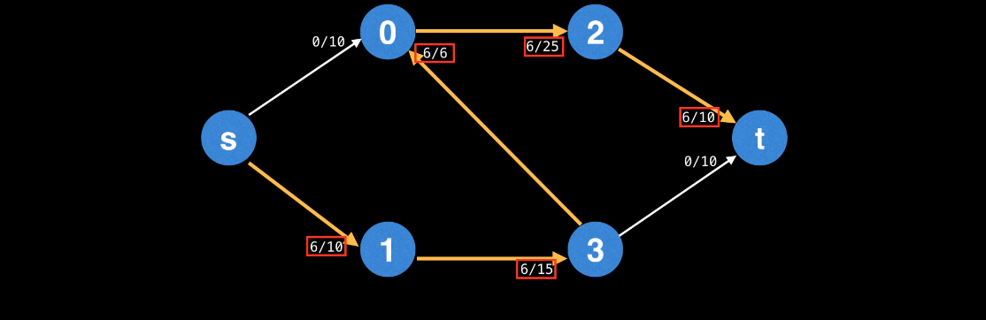
Step1: Find A path

Slide 7
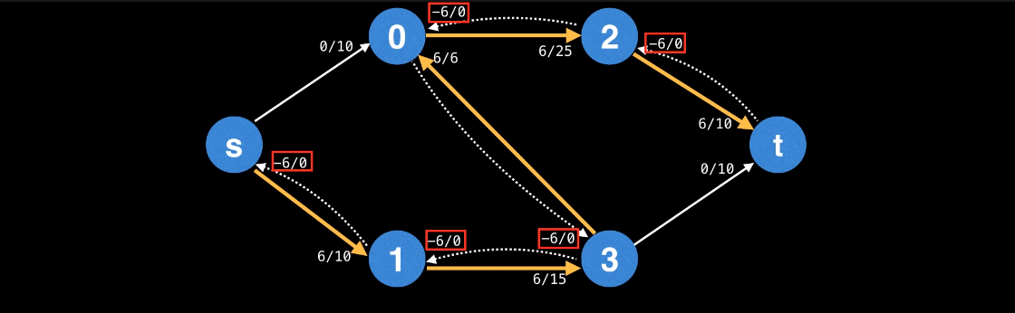
Step1: Find A path
Step2: Add Residual Edge

Slide 8
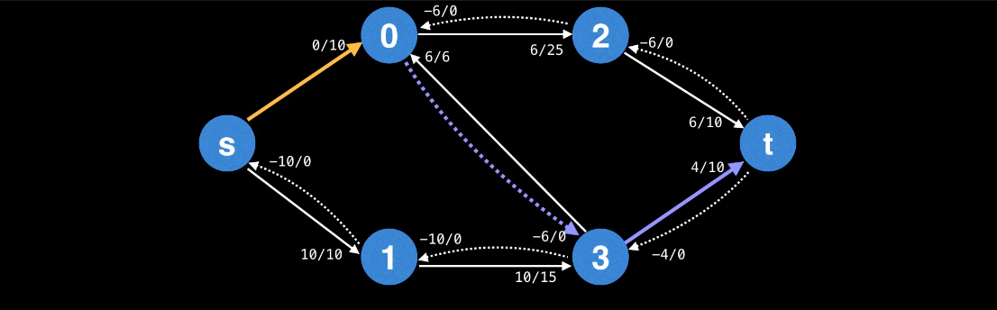
Step1: Find A path
Step2: Add Residual Edge
Step3: Repeat Step1, Considering new Reidual Edge

Slide 9
Step1: Find A path (DFS/BFS)
Step2: Add Residual Edge
Step3: Repeat Step1, Considering new Reidual Edge

Slide 10
Graph-cut: Min-cut
Source
Residual = 0
Sink
Residual = 0
Residual =/= 0
Residual =/= 0

Slide 11

Interaction Penalty
$$C\left(l\right)= \sum_{p}{C_{d}\left(p, L\left(p\right)\right) }+\sum_{p,q}{C_{i}(p, q, L\left(p), L(q\right))}$$
Data Penalty
Designated Image:
Small Penalty
Large Penalty
User Assign Labels
Resulting Penalty

Slide 12

Interaction Penalty
$$C\left(l\right)= \sum_{p}{C_{d}\left(p, L\left(p\right)\right) }+\sum_{p,q}{C_{i}(p, q, L\left(p), L(q\right))}$$
Data Penalty
Designated Color:
(Least/Max Simliarity)
Small Penalty
Large Penalty
User Assign Labels
Resulting Penalty

Slide 13
Interaction Penalty
$$C\left(l\right)= \sum_{p}{C_{d}\left(p, L\left(p\right)\right) }+\sum_{p,q}{C_{i}(p, q, L\left(p), L(q\right))}$$
Data Penalty
Designated Color
Luminace
Likelihood

Slide 14
Interaction Penalty
$$C\left(l\right)= \sum_{p}{C_{d}\left(p, L\left(p\right)\right) }+\sum_{p,q}{C_{i}(p, q, L\left(p), L(q\right))}$$
Data Penalty
Designated Color
Luminace
Likelihood
Eraser
…

Slide 15
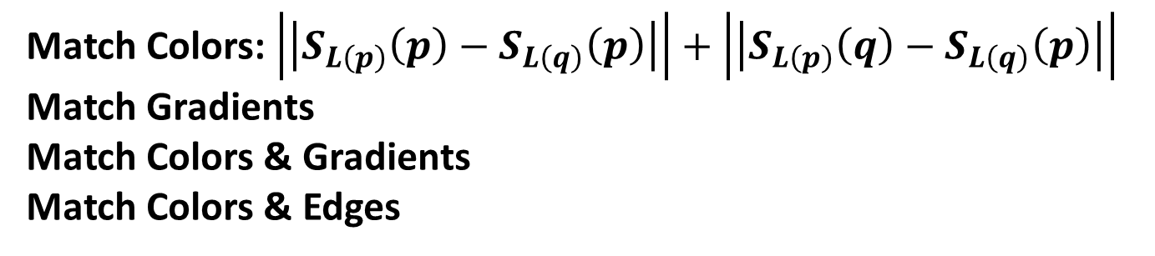

Interaction Penalty
$$C\left(l\right)= \sum_{p}{C_{d}\left(p, L\left(p\right)\right) }+\sum_{p,q}{C_{i}(p, q, L\left(p), L(q\right))}$$
Seam Penalty
Match Colors: $\left|\left|S_{L\left(p\right)}\left(p\right)−S_{L\left(q\right)}\left(p\right)\right|\right|+\left|\left|S_{L\left(p\right)}\left(q\right)−S_{L\left(q\right)}\left(p\right)\right|\right|$
Match Gradients
Match Colors & Gradients
Match Colors & Edges

Slide 16
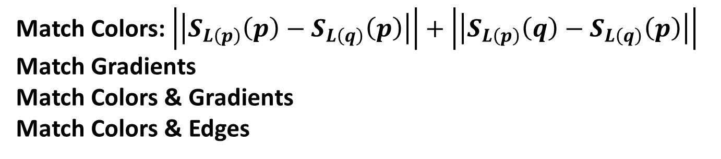
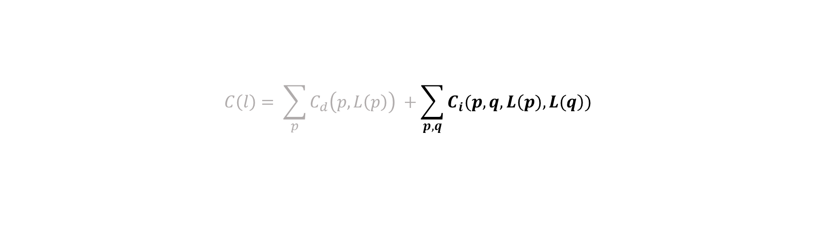
Interaction Penalty
L(p)
L(q)
p
p’
$$C\left(l\right)= \sum_{p}{C_{d}\left(p, L\left(p\right)\right) }+\sum_{p,q}{C_{i}(p, q, L\left(p), L(q\right))}$$
q’
q
Seam Penalty
Match Colors: $\left|\left|S_{L\left(p\right)}\left(p\right)−S_{L\left(q\right)}\left(p\right)\right|\right|+\left|\left|S_{L\left(p\right)}\left(q\right)−S_{L\left(q\right)}\left(p\right)\right|\right|$
Match Gradients
Match Colors & Gradients
Match Colors & Edges

Slide 17
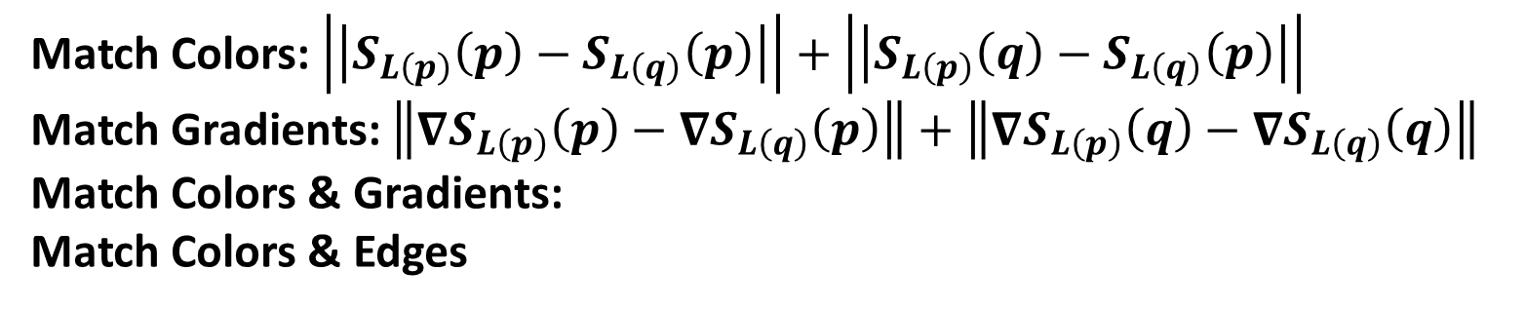
Interaction Penalty
$$C\left(l\right)= \sum_{p}{C_{d}\left(p, L\left(p\right)\right) }+\sum_{p,q}{C_{i}(p, q, L\left(p), L(q\right))}$$
Seam Penalty
Match Colors: $\left|\left|S_{L\left(p\right)}\left(p\right)−S_{L\left(q\right)}\left(p\right)\right|\right|+\left|\left|S_{L\left(p\right)}\left(q\right)−S_{L\left(q\right)}\left(p\right)\right|\right|$
Match Gradients: $\left\|∇S_{L\left(p\right)}\left(p\right)−∇S_{L\left(q\right)}\left(p\right)\right\|+\left\|∇S_{L\left(p\right)}\left(q\right)−∇S_{L\left(q\right)}\left(q\right)\right\|$
Match Colors & Gradients:
Match Colors & Edges

Slide 18
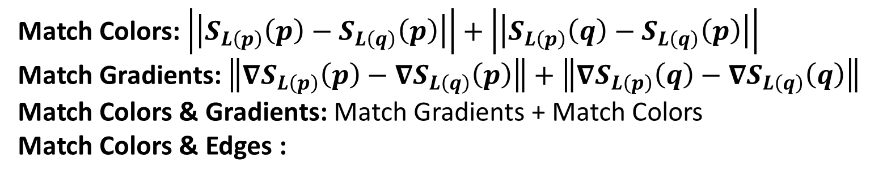
Interaction Penalty
$$C\left(l\right)= \sum_{p}{C_{d}\left(p, L\left(p\right)\right) }+\sum_{p,q}{C_{i}(p, q, L\left(p), L(q\right))}$$
Seam Penalty
Match Colors: $\left|\left|S_{L\left(p\right)}\left(p\right)−S_{L\left(q\right)}\left(p\right)\right|\right|+\left|\left|S_{L\left(p\right)}\left(q\right)−S_{L\left(q\right)}\left(p\right)\right|\right|$
Match Gradients: $\left\|∇S_{L\left(p\right)}\left(p\right)−∇S_{L\left(q\right)}\left(p\right)\right\|+\left\|∇S_{L\left(p\right)}\left(q\right)−∇S_{L\left(q\right)}\left(q\right)\right\|$
Match Colors & Gradients: Match Gradients + Match Colors
Match Colors & Edges :

Slide 19
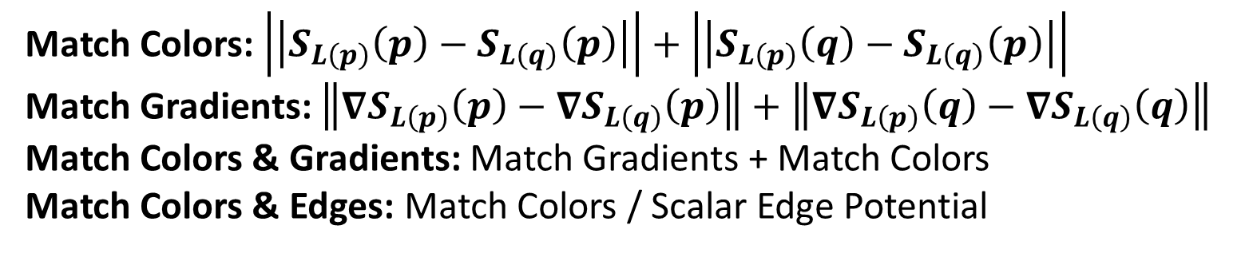
Interaction Penalty
$$C\left(l\right)= \sum_{p}{C_{d}\left(p, L\left(p\right)\right) }+\sum_{p,q}{C_{i}(p, q, L\left(p), L(q\right))}$$
Seam Penalty
Match Colors: $\left|\left|S_{L\left(p\right)}\left(p\right)−S_{L\left(q\right)}\left(p\right)\right|\right|+\left|\left|S_{L\left(p\right)}\left(q\right)−S_{L\left(q\right)}\left(p\right)\right|\right|$
Match Gradients: $\left\|∇S_{L\left(p\right)}\left(p\right)−∇S_{L\left(q\right)}\left(p\right)\right\|+\left\|∇S_{L\left(p\right)}\left(q\right)−∇S_{L\left(q\right)}\left(q\right)\right\|$
Match Colors & Gradients: Match Gradients + Match Colors
Match Colors & Edges: Match Colors / Scalar Edge Potential

Slide 20
Spatial Constaint: Inertia

Slide 21

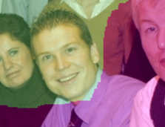

Gradient Domain Fushion
Rational:
There are artifacts in boundries even graph cuts cannot resolve
Before GDF
After

Slide 22
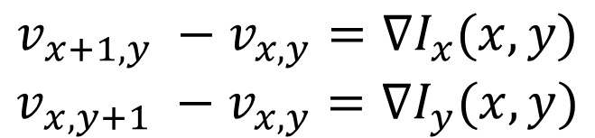
Gradient Domain Fushion
Rational:
There are artifacts in boundries even graph cuts cannot resolve
Before GDF
Solution (Neumann Boundries):
$$v_{x+1,y} −v_{x,y}=∇I_{x}(x, y)$$
$$v_{x,y+1} −v_{x,y}=∇I_{y}(x, y)$$
After

Slide 23
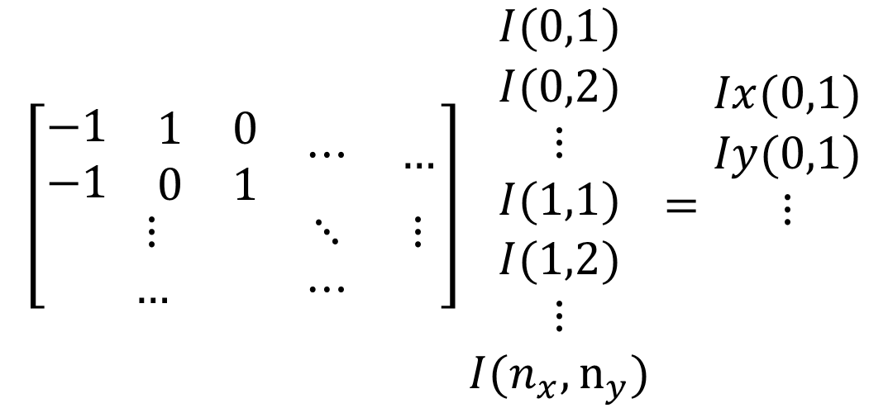
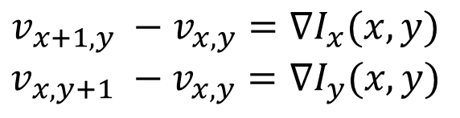
Gradient Domain Fushion
Solution (Neumann Boundries):
Before GDF
$$v_{x+1,y} −v_{x,y}=∇I_{x}(x, y)$$
$$v_{x,y+1} −v_{x,y}=∇I_{y}(x, y)$$
$$\left[\begin{matrix}\begin{matrix}−1 & \begin{matrix}1 & 0\end{matrix} \\ −1 & \begin{matrix}0 & 1\end{matrix}\end{matrix} & ⋯ & … \\ ⋮ & ⋱ & ⋮ \\ … & ⋯ & \end{matrix}\right]\begin{matrix}I(0,1) \\ I(0,2) \\ \begin{matrix}⋮ \\ I(1,1) \\ \begin{matrix}I(1,2) \\ ⋮ \\ I(n_{x}, n_{y})\end{matrix}\end{matrix}\end{matrix}=\begin{matrix}Ix(0,1) \\ Iy(0,1) \\ \begin{matrix}⋮ \\ \\ \end{matrix}\end{matrix}$$
After

Slide 24
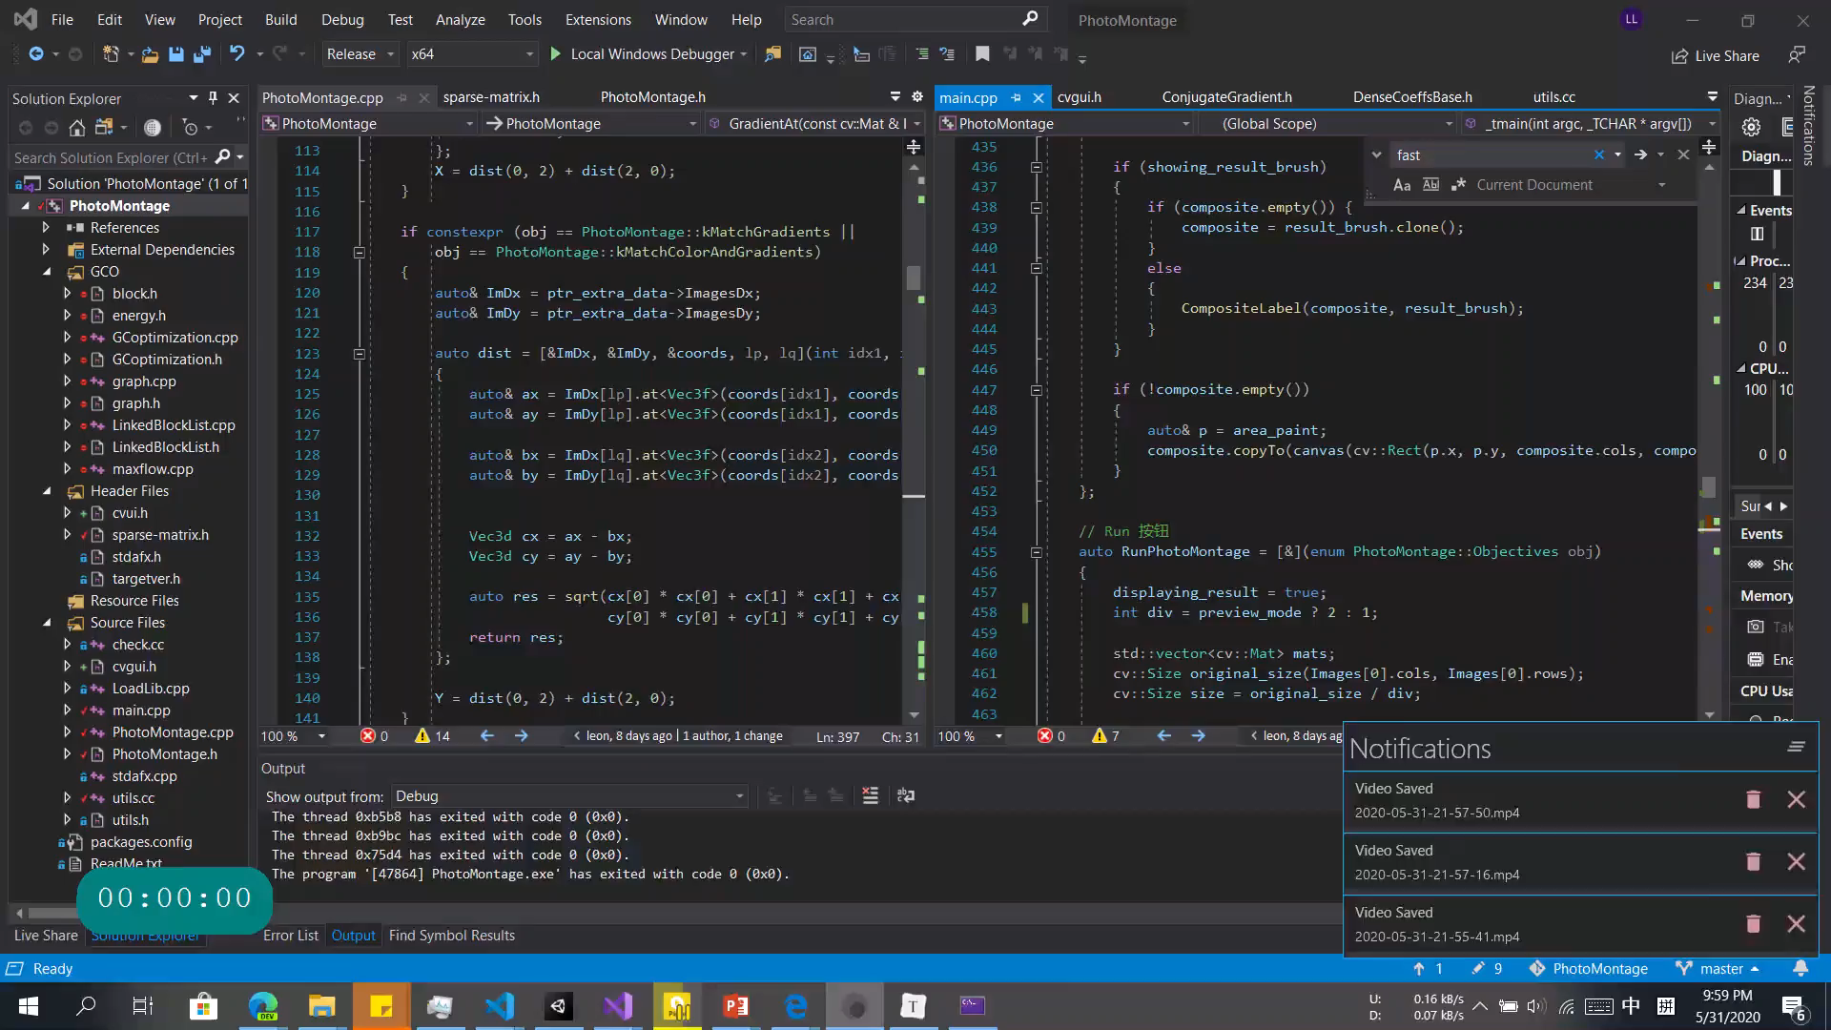

Slide 25
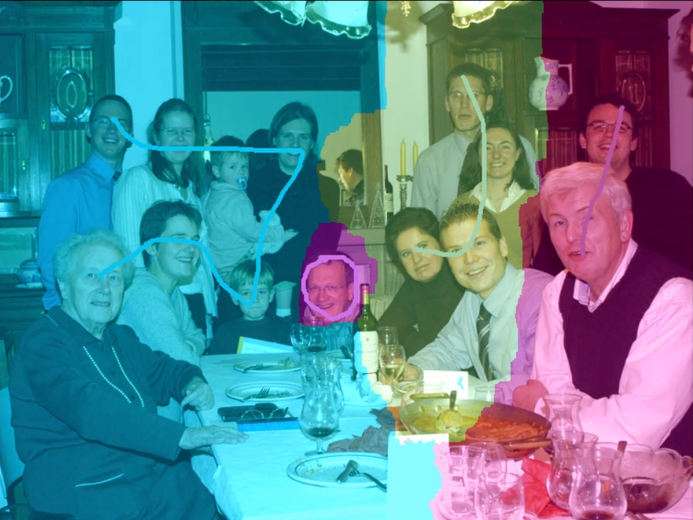
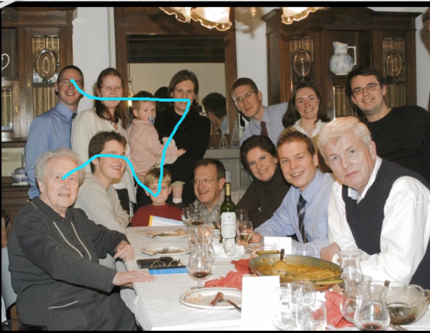
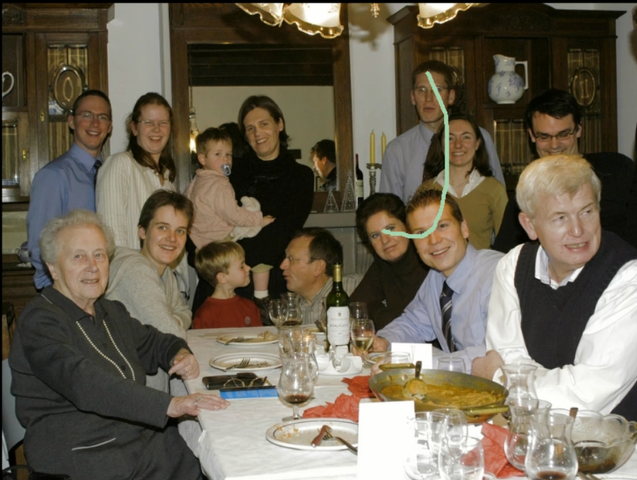
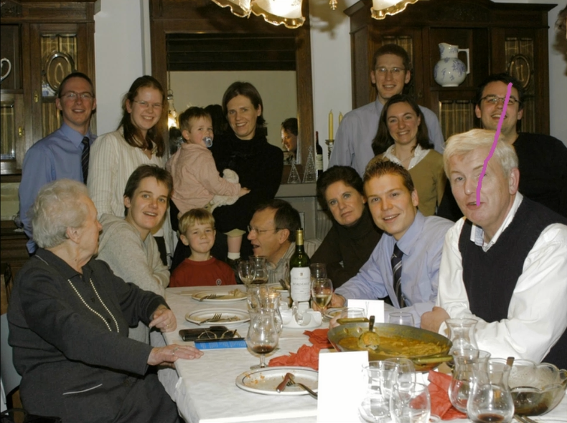
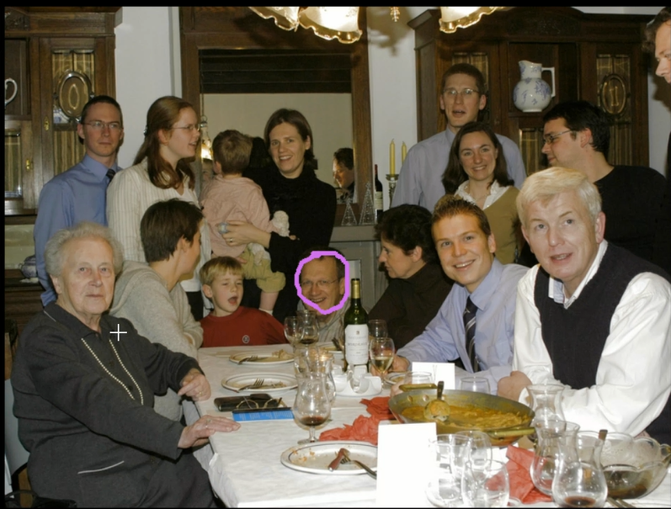
Result & Analysis
Match Gradients

Slide 26
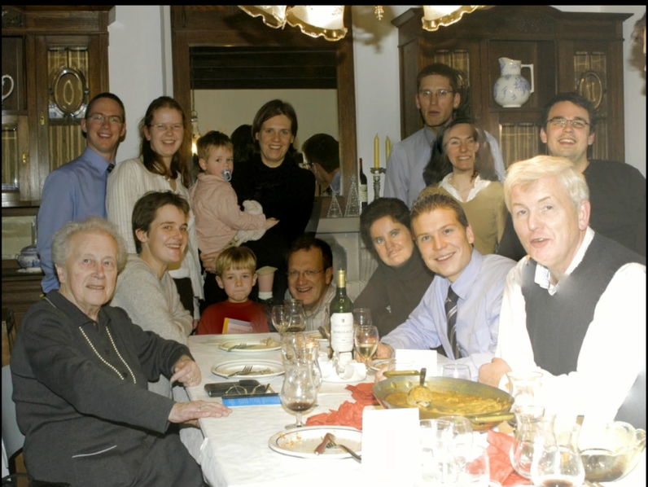
Result & Analysis
Match Gradients
Match Colors

Slide 27
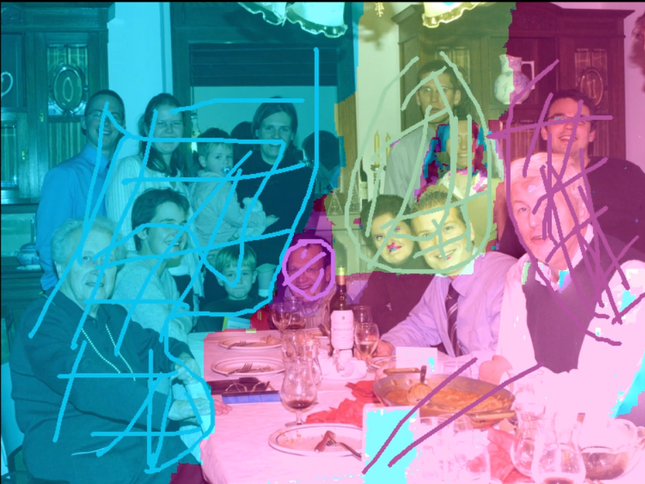
Result & Analysis
Match Gradients
Match Colors

Slide 28
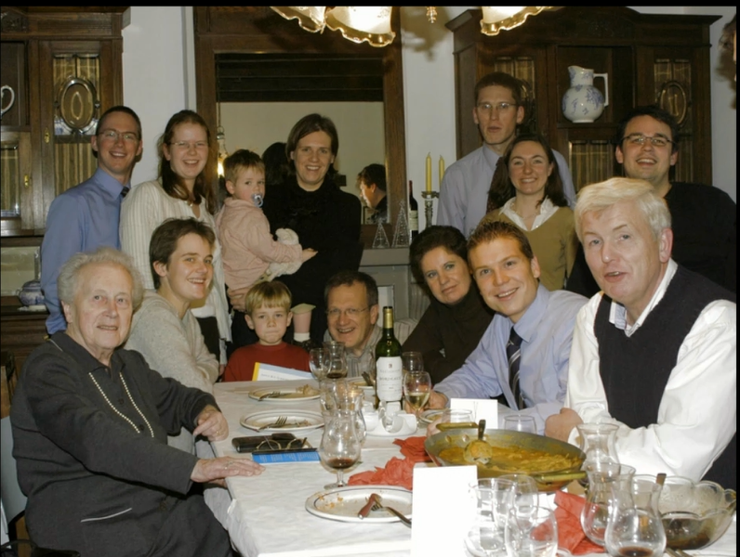
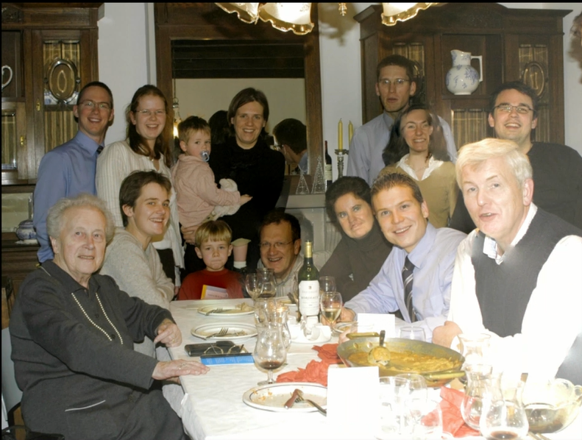
Result & Analysis
Match Gradients
Match Colors

Slide 29
Result & Analysis
Gradients are better than colors:
Robust to illumation changes
Better capturing locality
Better maintaining shapes of objects

Slide 30
Result & Analysis
More Brush Strokes
More Iterations
Match Gradients
Match Colors

Slide 31
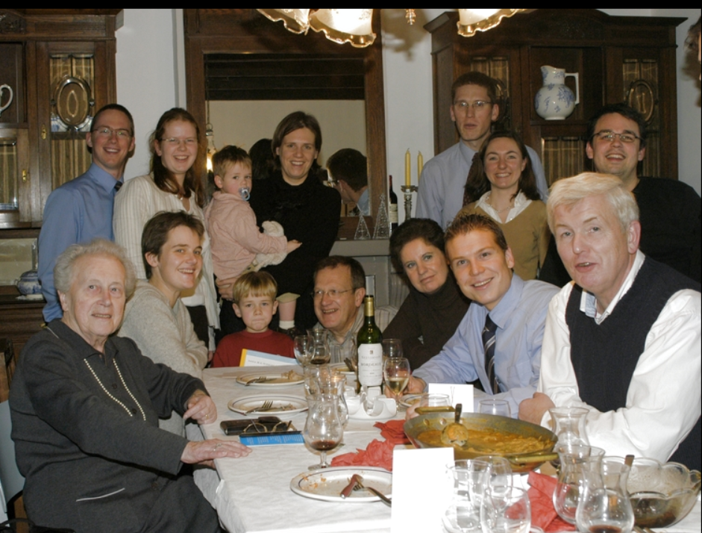
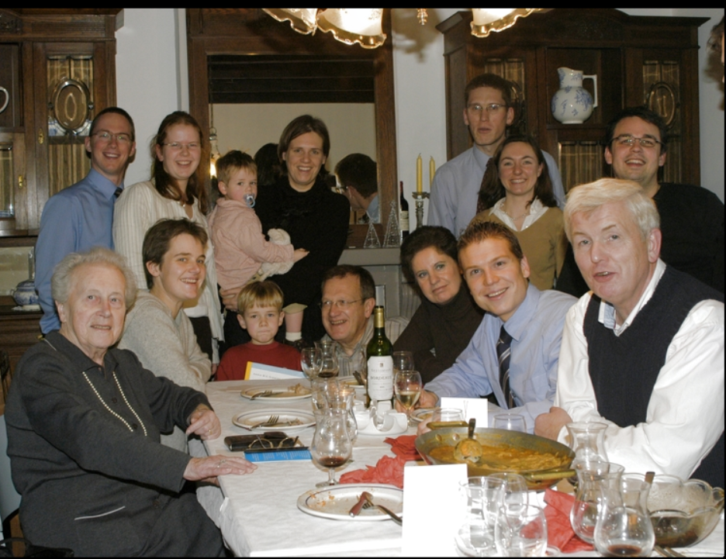
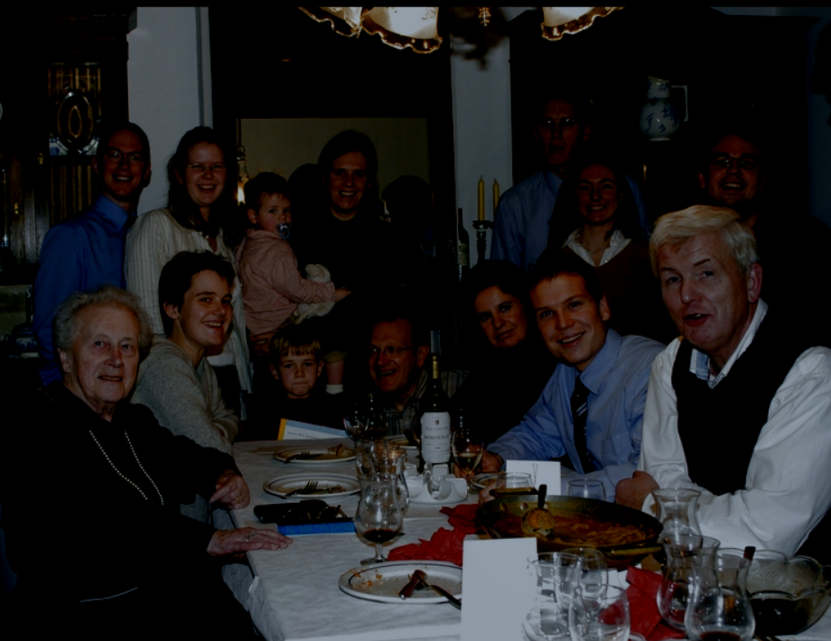
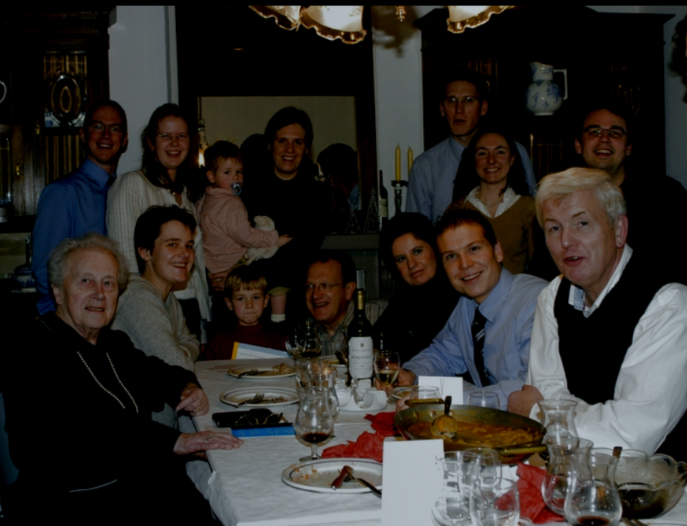
Result & Analysis
1000 Iterations
2000 Iterations
3000 Iterations
4000 Iterations
Notes:
在我最初的实现里面，需要3-4分钟才能出结果，性能的瓶颈是 Gradient Domain Fushion, 我们可以对比一下不同迭代次数的图片会发现这么慢的原因是这张图片是从 0 开始迭代的

Slide 32
Result & Analysis
Always starts from 0,
This is slow.
Solution: we have a rough idea
how image should be.
1000 Iterations
2000 Iterations
3000 Iterations
4000 Iterations

Slide 33
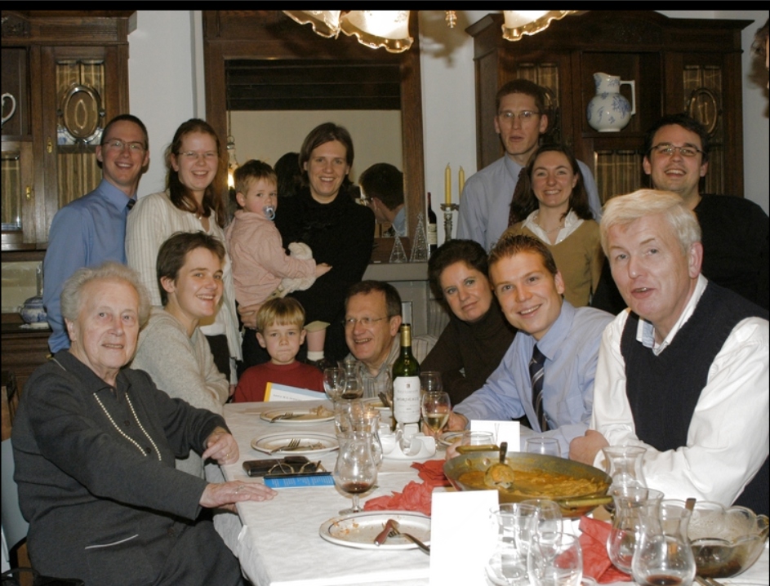
Result & Analysis
Always starts from 0,
This is slow.
Solution: we have a rough idea
how image should be.
3000 Iterations, Old methods
50 Iterations, New methods

Slide 34
Result & Analysis
Always starts from 0,
This is slow.
Solution: we have a rough idea
how image should be.
Match | Times (Iterations) Old Method | Times (Iterations) New Method
Match Colors | 44738ms (3000) | 3143ms (50)
Match Gradients | 55201ms (3000) | 15111ms (50)
Match Colors & Edges | 45186ms (3000) | 3349ms (50)

Slide 35
Discussions & Future Works
This technique be futher applied to incremental changes in response to user input.
Segmentation is now the bottle neck of performance.

Slide 36
Thank you For your attention
Questions?

